Slide 1
Superheterodyne receiver
Submitted By:
Md.Shiplu Ahmed
id.11809042
Department of ICT
Comilla University
Submitted To:
Md.Imran Hossain
Assistant professor
Department of ICT
Comilla University

Slide 2
What is superheterodyne?
A superheterodyne receiver, often shortened to superhet, is a type of radio receiver that uses frequency mixing to convert a received signal to a fixed intermediate frequency (IF) which can be more conveniently processed than the original carrier frequency.
One of the most common forms of radio receiver is the superhet or superheterodyne radio receiver. Virtually all broadcast radio receivers, as well as televisions, short wave receivers and commercial radios have used the superheterodyne principle as the basis of their operation.

Slide 3
The superheterodyne radio receiver, although the RF circuit design is more complicated than some other forms of radio set, offers many advantages in terms of performance, particularly its selectivity.
The superhet radio converts signals to a fixed frequency intermediate frequency, and this enables it to remove unwanted signals more effectively than other forms like the TRF (Tuned Radio Frequency) sets or even regenerative radios that were used particularly in the early days of radio.

Slide 4
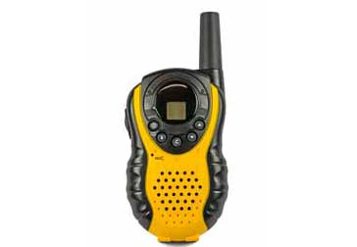
Superheterodyne radio applications & usage:
The superheterodyne was used in every form of radio from domestic broadcast radios to walkie talkies, television sets, through to hi-fi tuners and professional communications radios, satellite base stations and much more.

Slide 5
Superheterodyne receiver circuit blocks:
Often to provide improved performance additional frequency conversions are included to improve the separation between the wanted signal and the image response. Nevertheless the same basic principles are used and often the same types of circuit blocks are used, although the overall topology is different.

Slide 6
The main types of circuit bock used in the RF circuit design for superhet receivers is given below:
RF tuning & amplification:
This RF stage within the overall block diagram for the receiver provides initial tuning to remove the image signal. It also provides some amplification. There are many different approaches used within the RF circuit design for this block dependent its application.

Slide 7
Local oscillator:
Today most receivers use one or more of a variety of forms frequency synthesizer. The most common approach in the RF circuit design is to use a phase locked loop approach. Single and multi-loop synthesizers are used dependent upon the requirements, performance, cost and the like. Direct digital synthesizers are also being used increasingly.

Slide 8
Mixer:
The mixer can be one of the key elements within the overall RF design of the receiver. Ensuring that the mixer performance matches that of the rest of the radio is particularly important.
Both the local oscillator and incoming signal enter this block within the superheterodyne receiver. The wanted signal is converted to the intermediate frequency.

Slide 9
IF amplifier & filter:
This superheterodyne receiver block provides the majority of gain and selectivity. Often comparatively little gain will be provided in the previous blocks of the RF circuit design of the radio.
The IF stages are where the main gain is provided. Being fixed in frequency, it is much easier to achieve high levels of gain and overall performance.
Originally the IF stage might have included a number of different transistors, FETs or thermionic valves / vacuum tubes and other electronic components, but nowadays it is possible to obtain integrated circuits that contain a complete IF strip.

Slide 10
Demodulator:
Even many broadcast radios will have AM and FM, but professional radios used for monitoring and two way radio communications may require a larger variety in some instances. Having a variety of demodulators will enable many different signal modes to be received and increase the capability of the radio.

Slide 11
Automatic Gain Control, AGC:
Although the basic concept is the same through all radio RF circuit designs, there are some variations in the implementation and the electronic circuit design required. Some of the key variations are the time constant of the AGC system. For AM and the like a relatively slow time constant is acceptable. For SSB, a shorter time constant is needed so that the envelope of the SSB signal is followed.

Slide 12
Audio amplifier:
Once demodulated, the recovered audio is applied to an audio amplifier block to be amplified to the required level for loudspeakers or headphones. Alternatively the recovered modulation may be used for other applications whereupon it is processed in the required way by a specific circuit block.

Slide 13
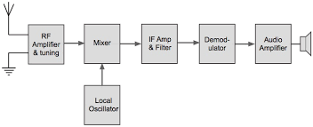
Basic Superheterodyne receiver block diagram :
Signals enter the receiver from the antenna and are applied to the RF amplifier where they are tuned to remove the image signal and also reduce the general level of unwanted signals on other frequencies that are not required.

Slide 14
Block diagram summary:
The diagram above shows a very basic version of the superhet or superheterodyne receiver.
Many sets these days are far more complicated.
Some superhet radios have more than one frequency conversion, and other areas of additional circuitry to provide the required levels of performance.

Slide 15
Superheterodyne Principle:
In the Superheterodyne Principle, the incoming signal voltage is combined with a signal generated in the receiver.
This local oscillator voltage is normally converted into a signal of a lower fixed frequency. The signal at this intermediate frequency contains the same modulation as the original carrier, and it is now amplified and detected to reproduce the original information. The superhet has the same essential components as the TRF receiver, in addition to the mixer, local oscillator and intermediate-frequency (IF) amplifier.

Slide 16
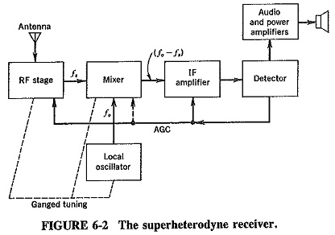

Slide 17
The following example shows the Superheterodyne Receiver tuning process:
Select an AM station, 640 kHz.
Tune the RF amplifier to the lower end of the AM band.
Tune the RF amplifier. This also tunes the local oscillator to a predetermined frequency of 1095 kHz.
Mix the 1095 kHz and 640 kHz. This produces the following signals at the output of the mixer circuit; these signals are then fed to the IF amplifier:
1.095-MHz local oscillator frequency
640-kHz AM station carrier frequency
455-kHz difference frequency
1.735-MHz sum frequency

Slide 18
Advantages of Superheterodyne Receiver:
The advantages of the superheterodyne receiver make it the most suitable type for the great majority of radio receiver applications;
AM, FM, communications, single-sideband, television and even radar receivers all use it, with only slight modifications in Superheterodyne Principle.

Slide 19
Thank you

